Slide 1



Slide 2
Content
Linear Search
Binary Search
Hashing-Concept
Hash Functions
Collision resolution Techniques

Slide 3
Searching in Data Structure
The process of finding the desired information from the set of items stored in the form of elements in the computer memory is referred to as ‘searching in data structure’.
These sets of items are in various forms, such as an array, tree, graph, or linked list.
Another way of defining searching in the data structure is by locating the desired element of specific characteristics in a collection of items.

Slide 4
Linear Search
The linear search algorithm searches all elements in the array sequentially.
Its best execution time is one, whereas the worst execution time is n, where n is the total number of items in the search array.
It is the most simple search algorithm in data structure and checks each item in the set of elements until it matches the search element until the end of data collection.
When data is unsorted, a linear search algorithm is preferred.
Space Complexity
Space complexity for linear search is O(n) as it does not use any extra space where n is the number of elements in an array.

Slide 5
Linear Search
Time Complexity
Best- case complexity = O(1) occurs when the search element is present at the first element in the search array.
Worst- case complexity = O(n) occurs when the search element is not present in the set of elements or array.
Average complexity = O(n) is referred to when the element is present somewhere in the search array

Slide 6
Linear Search
Example,
45, 78, 12, 67, 08, 51, 39, 26
To find ‘51’ in an array of 8 elements given above, a linear search algorithm will check each element sequentially till its pointer points to 51 in the memory space. It takes O(6) time to find 51 in an array. To find 12, in the above array, it takes O(3), whereas, for 26, it requires O(8) time.
Algorithm

Slide 7
Binary Search
Very efficient searching technique.
Works for sorted/ordered array.
To find an element,
Set the range on index(es) in which element is to be searched, there are 3 cases,
If it matches, element is at middle index
If search value is less than value at middle index, then upper bound is shifted to the first half of the array.
If search value is greater than value at middle index, then lower bound is shifted to the second half of the array.
The process is repeated until element is found or search space terminates.

Slide 8
Binary Search (ITERATIVE)

Slide 9
Binary Search (Recursive)

Slide 10
Hashing
Searching is the most frequently used operation on various data structure like arrays, linked list, trees etc.
Searching operation should be as efficient as possible i.e. less time consuming.
Linked List – O(n)
Array (unsorted) – O(n)
Array (Sorted) – O(log n)
Hash table – O(1)

Slide 11
Hash table
Hash table is a data structure which stores data in an array format of fixed size.
In hash table, the data is stored in the form of key / value pair.
Using of hash function, it computes an index of an array where the data value to be stored.
If the table size is referred to as TableSize, then the table have a range from 0 to TableSize-1 indexes in which each index is unique.

Slide 12
Hashing
Hashing is an implementation of hash table.
It is a technique used to maps each key value into some number in the range from 0 to TableSize.
It is mainly used to perform insertion, deletion and finding an element in a constant average time O(1) but it does not support any ordering such as find minimum and find maximum.
There are several hash methods available such as Direct, Subtraction, Modulo division, Folding, Mid-square, Random generation etc.

Slide 13
Examples of Hashing
In schools, the teacher assigns a unique roll number to each student. Later, the teacher uses that roll number to retrieve information about that student.
A library has an infinite number of books. The librarian assigns a unique number to each book. This unique number helps in identifying the position of the books on the bookshelf.

Slide 14
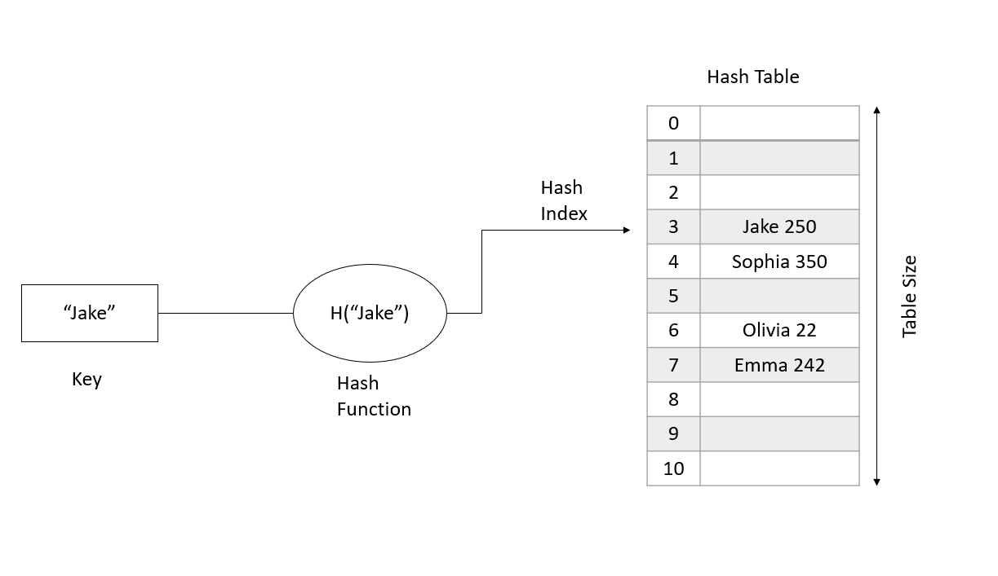
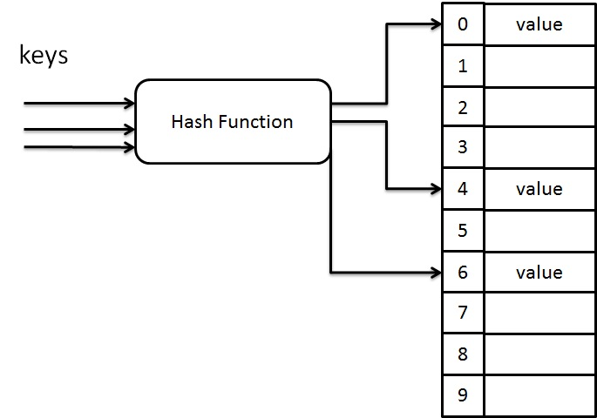
Hashing

Slide 15
Hash Function
It is a function that can be used to map dataset of arbitrary size to dataset of fixed size which falls into the the hash table i.e 0 to tablesize-1.
Values returned by the hash function are called hash values, hash codes, hash sums or simply hashes.
Main characteristics of good hash function
Easy to compute
Even Distribution
Minimize collision
Perfect hashing – hash functions maps each valid input to a different hash value i.e. no collision.

Slide 16
Hash Function 1 – Division method
In this method, key k is mapped into n locations or indices by finding the modulus or remainder of key k by n.
It requires only a single division operation, hence it is fast.

Slide 17
Hash Function 1 – Division method

Slide 18
Hash Function 2 – Multiplication method
This method has two steps
The key value ‘k’ is multiplied by a constant c in the range o<c<1 and extract the fractional part of the value k*c
The fractional part obtained is multiplied by ‘n’ (no. of indices) and floor of the result is taken as hash value.

Slide 19
Hash Function 2 – Multiplication method

Slide 20
Hash Function 3 – Midsquare method
This method has two steps
The square of key value ‘k’ is taken
According to the size of hash table i.e n,
n digits are extracted from the middle of square as index.

Slide 21
Hash Function 3 – Midsquare method

Slide 22
Hash Function 4 – folding method
This method has two steps
The key value K is divided into number of parts k1, k2, ….km; where each part has same number of digits except for the last part, which can have lesser number of digits.
These parts are added together and hash value is obtained by ignoring the last carry, if any.

Slide 23
Hash Function 4 – folding method

Slide 24
Hash Function 4 – folding method

Slide 25
Collision Resolution
When two keys are hashed to same location, then this situation is called collision.
Two keys mapped to the same hash value.
This will be avoided by using two simple methods.
Open Hashing (Separate Chaining)
Closed Hashing (Open Addressing)

Slide 26
Closed Hashing (Open Addressing)
In Open addressing, the elements are hashed to the table itself.
If two elements hash to the same location, a collision occurs.
To resolve the collision, an empty location is searched for.
The hash function for open addressing is given as, generally,

Slide 27
Closed Hashing (Open Addressing)
Open addressing needs a large table than separate chaining because all the data will be stored inside the hash table.
There are 3 collision resolution techniques:
Linear Probing
Quadratic Probing
Double Hashing

Slide 28
Closed Hashing - Linear Probing
To resolve collision, colliding records are stored in next available memory location.
This technique is known as linear probing.
Linear probing resolves hash collision by sequentially searching a hash table beginning at the location returned by the hash function.

Slide 29
Closed Hashing - Linear Probing Example
Insert keys 99, 33, 23, 44, 56, 43,19 into a hash table with n=10 and hash function is division method, using linear probing.

Slide 30
Closed Hashing - Linear Probing Example
Insert keys 99, 33, 23, 44, 56, 43,19 into a hash table with n=10 and hash function is division method, using linear probing.

Slide 31
Closed Hashing - Linear Probing Example
Insert keys 99, 33, 23, 44, 56, 43,19 into a hash table with n=10 and hash function is division method, using linear probing.

Slide 32
Closed Hashing - Linear Probing Example
Insert keys 99, 33, 23, 44, 56, 43,19 into a hash table with n=10 and hash function is division method, using linear probing.

Slide 33
Closed Hashing - Linear Probing Example
Insert keys 99, 33, 23, 44, 56, 43,19 into a hash table with n=10 and hash function is division method, using linear probing.

Slide 34
Closed Hashing - Linear Probing Example
Insert keys 99, 33, 23, 44, 56, 43,19 into a hash table with n=10 and hash function is division method, using linear probing.

Slide 35
Closed Hashing - Linear Probing Example
Insert keys 99, 33, 23, 44, 56, 43,19 into a hash table with n=10 and hash function is division method, using linear probing.

Slide 36
Problem with Linear Probing
The problem with linear probing is primary clustering.
This means that even if the table is empty, any key that hashes to table requires several attempt to resolve the collision because it has to cross over the blocks of occupied cell.
These blocks of occupied cell form the primary clustering.
If any key falls into clustering, then we cannot predict the number of attempts needed to resolve the collision.
These long paths affect the performance of the hash table.

Slide 37
Closed Hashing - Quadratic Probing
Quadratic probing

Slide 38
Closed Hashing - Quadratic Probing Example
Insert keys 99, 33, 23, 44, 56, 43,19 into a hash table with n=10 and hash function is division method, using quadratic probing.

Slide 39
Closed Hashing - Quadratic Probing Example
Insert keys 99, 33, 23, 44, 56, 43,19 into a hash table with n=10 and hash function is division method, using quadratic probing.

Slide 40
Closed Hashing - Quadratic Probing Example
Insert keys 99, 33, 23, 44, 56, 43,19 into a hash table with n=10 and hash function is division method, using quadratic probing.

Slide 41
Closed Hashing - Quadratic Probing Example
Insert keys 99, 33, 23, 44, 56, 43,19 into a hash table with n=10 and hash function is division method, using quadratic probing.

Slide 42
Closed Hashing - Quadratic Probing Example
Insert keys 99, 33, 23, 44, 56, 43,19 into a hash table with n=10 and hash function is division method, using quadratic probing.

Slide 43
Closed Hashing - Quadratic Probing Example
Insert keys 99, 33, 23, 44, 56, 43,19 into a hash table with n=10 and hash function is division method, using quadratic probing.

Slide 44
Closed Hashing - Quadratic Probing Example
Insert keys 99, 33, 23, 44, 56, 43,19 into a hash table with n=10 and hash function is division method, using quadratic probing.

Slide 45
Problem with Linear Probing
Although, the quadratic probing eliminates the primary clustering, it still has the problem.
When two keys hash to the same location, they will probe to the same alternative location.
This may cause secondary clustering.
In order to avoid this secondary clustering, double hashing method is created where we use extra multiplications and divisions.

Slide 46
Closed Hashing – Double hashing
Double Hashing is a hashing collision resolution technique where we use 2 hash functions.
It is considered one of the best methods for collision resolution.

Slide 47
Closed Hashing - Double Probing Example
Insert keys 99, 33, 23, 44, 56, 43,19 into a hash table with n=10 and using double hashing for probing.

Slide 48
Closed Hashing - Double Probing Example
Insert keys 99, 33, 23, 44, 56, 43,19 into a hash table with n=10 and using double hashing for probing.

Slide 49
Closed Hashing - Double Probing Example
Insert keys 99, 33, 23, 44, 56, 43,19 into a hash table with n=10 and using double hashing for probing.

Slide 50
Closed Hashing - Double Probing Example
Insert keys 99, 33, 23, 44, 56, 43,19 into a hash table with n=10 and using double hashing for probing.

Slide 51
Closed Hashing - Double Probing Example
Insert keys 99, 33, 23, 44, 56, 43,19 into a hash table with n=10 and using double hashing for probing.

Slide 52
Closed Hashing - Double Probing Example
Insert keys 99, 33, 23, 44, 56, 43,19 into a hash table with n=10 and using double hashing for probing.

Slide 53
Closed Hashing - Double Probing Example
Insert keys 99, 33, 23, 44, 56, 43,19 into a hash table with n=10 and using double hashing for probing.

Slide 54
Open Hashing (Separate Chaining)
This method maintains a list of all values that are hashed to the same location.
In this method, the hash data structure is slightly modified. Instead of storing the value in an array, hash table in open hashing uses a linked list.
Values will be stored in the linked list.
For ease of use, the Linked list has a header. Each index of an array points to one element of the linked list. Assume a value is inserted into the hash table. It is added to the linked list at the corresponding index in the array.
Hence, the collisions no longer happen since a linked list has no limit on its length. If more than one key point to the same array index, all the keys will be added to the linked list.

Slide 55
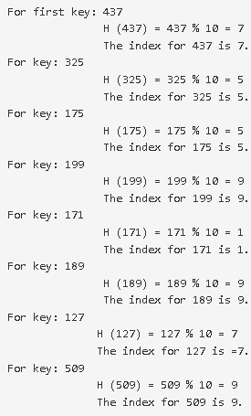
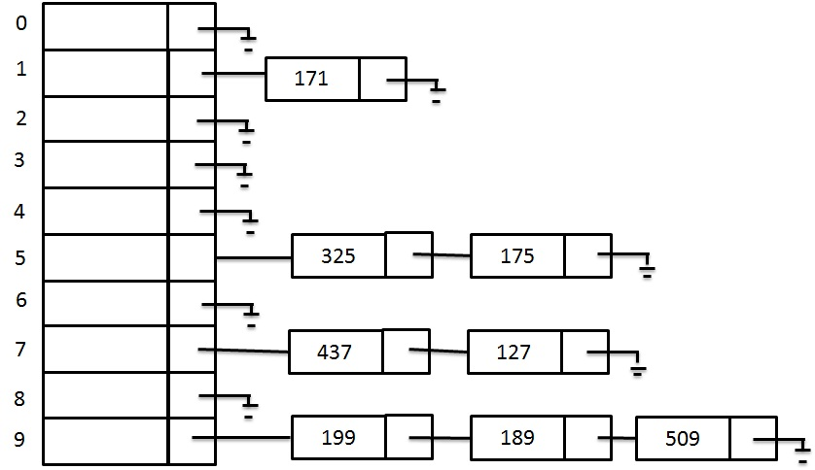
Open Hashing Example
Let us say that we have a sequence of numbers { 437, 325, 175, 199, 171, 189, 127, 509} and a hash function H(X) = X mod 10 Let us see the results of separate chaining hash table.

